Slide 1
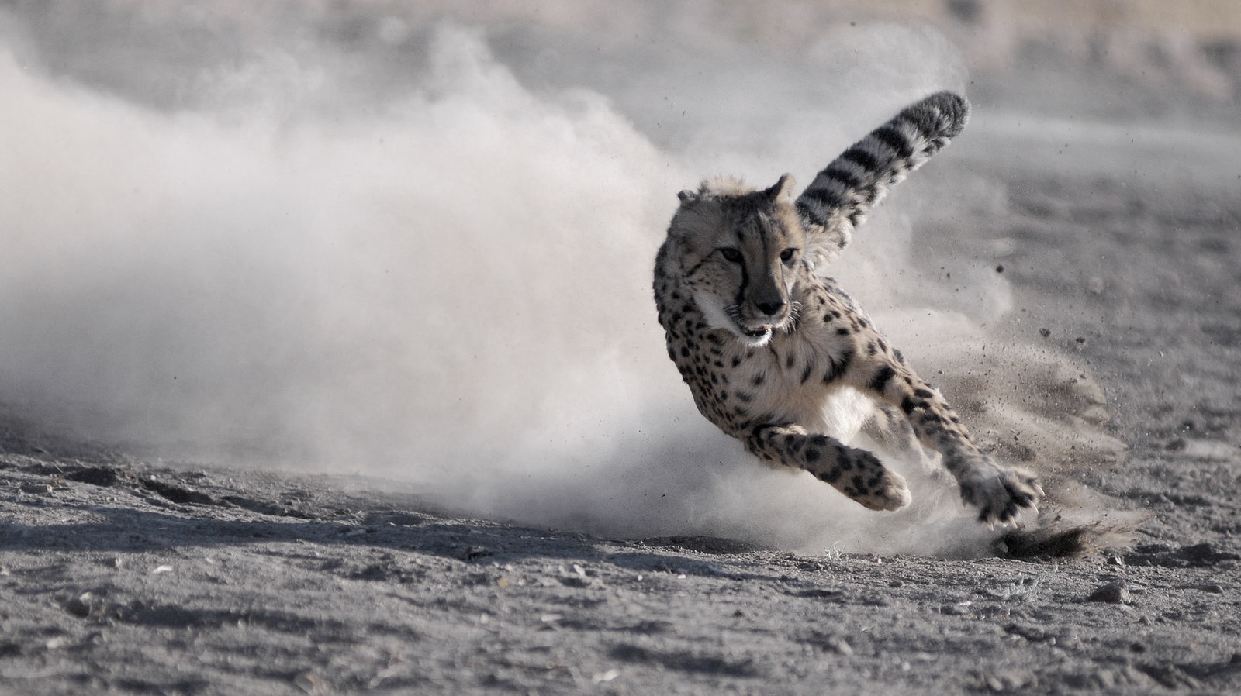

Cheetah Running Shoes
A Case Study by Wake Forest University
Lingrui Duan
Avi Lieberman
Wen Lu
Rahul Narula
Tiansheng Xu

Slide 2

Agenda
Optimizing Distribution Centers
Customer Service Tradeoff
Recommendations & Conclusion
Next Day Air Viability
Other Insights

Slide 3
Distribution Centers
Proposed & Existing
Two existing and 13 proposed distribution centers across 11 states, primarily in the Eastern US
Current Cost: $12,569,546
Goal: Under the given constraints, minimize the total cost of distribution from plant to each customer zone
ATLANTA
CHARLESTON
CHARLOTTE
CHATTANOOGA
CHICAGO
CINCINNATI
DALLAS
DENVER
GREENVILLE
INDIANAPOLIS
KNOXVILLE
LOUISVILLE
MEMPHIS
NASHVILLE
PITTSBURGH
Notes:
Context of the case
Currently, CRS has 2 DC’s and is proposing 13 more
Under the given constraints, which combination of DC’s is optimal?

Slide 4
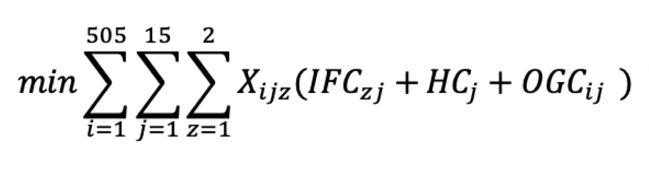
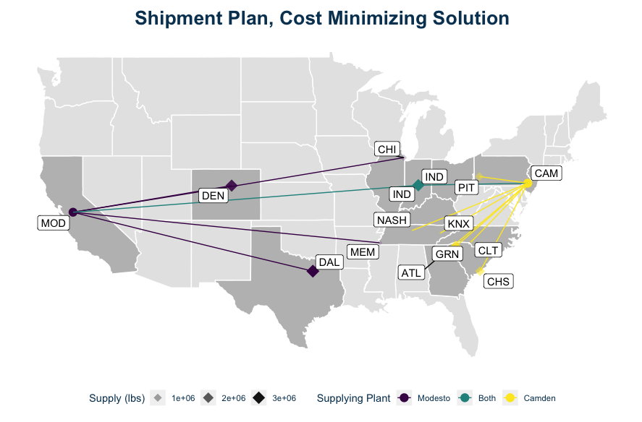
Optimization Approach
Objective Function:
Decision Variables:
Allocation Plan from Camden to 15 DCs
(1*15 = 15 )
Allocation Plan from Modesto to 15 DCs (1*15 = 15)
Allocation Plan from DCs to 505 customer zones (15*505 = 7575)
Constraints:
Plant capacity for Camden and Modesto
(1*2 = 2)
DC supply to customer zone (1*15 =15)
Customer demand for each customer zone (1*505 = 505)
Notes:
To solve this problem, we created our objective function, which aims to minimize the total cost of shipping to all customer zones
The corresponding decision variables are … and the constraints we operated under are …
(One thing to keep in mind: The map shown here does not show the new optimal solutions with 12 or 5 DC’s)

Slide 5
Camden Distribution
Optimal shipment to each DC (in millions of pounds)
0.369
2.821
Atlanta
Indianapolis
Georgia
Indiana
1.636
0.198
Charleston
Knoxville
South Carolina
Tennessee
Charlotte
0.269
0.142
Nashville
North Carolina
Tennessee
2.355
1.210
Greenville
Pittsburgh
South Carolina
Pennsylvania
Total: 9,000,000 lbs.
Notes:
The optimal solution suggests that the Camden plant should distribute to these eight DC’s
This plant is currently operating at capacity

Slide 6
Modesto Distribution
Optimal shipment to each DC (in millions of pounds)
0.563
Chicago
Illinois
1.014
Indianapolis
Indiana
Dallas
3.272
Texas
0.374
Memphis
Tennessee
Denver
2.832
Colorado
Total: 8,054,689 lbs.
Notes:
On the other hand, optimally, the Modesto plant only ships to five DC’s
One plant (Indianapolis) overlaps with Camden’s distribution, so the optimal solution includes shipping to 12 total DC’s
This plant is not operating at capacity

Slide 7

Break-Even
Current Distribution Plan
Limit distribution centers to current locations in Denver and Pittsburgh
The current distribution plan from the Camden and Modesto plants yields a total cost of $12,569,546
Optimal Distribution Plan
12 distribution centers in Atlanta, Charleston, Charlotte, Chicago, Dallas, Denver, Greenville, Indianapolis, Knoxville, Memphis, Nashville, Pittsburgh
The optimal distribution plan from the Camden and Modesto plants will yield a total cost of $11,554,958
= $1,014,588
Notes:
By changing their operations to the optimal solution, CRS can save over $1 million annually

Slide 8
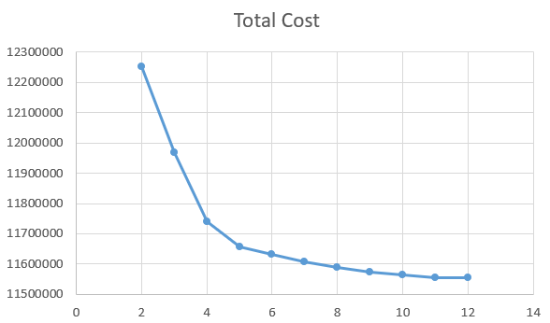
Optimal Number of DC’s
In the optimal solution, some distribution centers currently receive little inventory
The marginal profitability of building new distribution centers decreases as we increase the number of distribution centers
We computed all combinations of distribution centers at a given # of distribution centers and plotted the marginal decrease in total cost
The cost dropped dramatically when increasing the # of distribution centers to 5
Thus, taking into account the cost of building a distribution center, the optimal number of centers is likely 5
Notes:
However, in reality, there are costs necessary to build distribution centers
Analyzing the reduction caused by each marginal DC shows that after 5, there is little financial saving
In fact, the difference in savings between having 5 and having 12 DC’s is only ~$100,000
Thus, realistically, the optimal number of DC’s is likely 5
This number depends on the true costs of opening a DC, but we proceeded with 5 in subsequent analysis

Slide 9
Optimal 5 DC Plan
Optimal shipment to each DC (in millions of pounds)
Camden Distribution
Modesto Distribution
3.133
3.668
Greenville
Dallas
South Carolina
Texas
Pittsburgh
2.346
2.832
Denver
Pennsylvania
Colorado
Indianapolis
3.521
1.555
Indianapolis
Indiana
Indiana
Total: 9,000,000 lbs.
Total: 8,054,689 lbs.
Notes:
Using 5 DC’s, the optimal solution changes a bit
Each plant ships to three DC’s, again with Indianapolis receiving shipments from both
Again, Camden operates at capacity while Modesto doesn’t

Slide 10
Next Day Air
VS. Ground Shipping
In addition to shipping via ground, CRS has the option to ship to customers via air
While often faster, next day air is always more expensive than ground shipping
However, there may be reasons why CRS may opt to ship via air, such as additional benefits from customer satisfaction
Customer segmentation (via clustering) and analysis of shipping costs shows when these scenarios may arise
Notes:
The next issue to tackle was analyzing whether it makes sense for CRS to ship via air (next day shipping)
In all cases, next day shipping is more expensive than shipping via ground
However, there are scenarios in which air shipping may be preferable

Slide 11
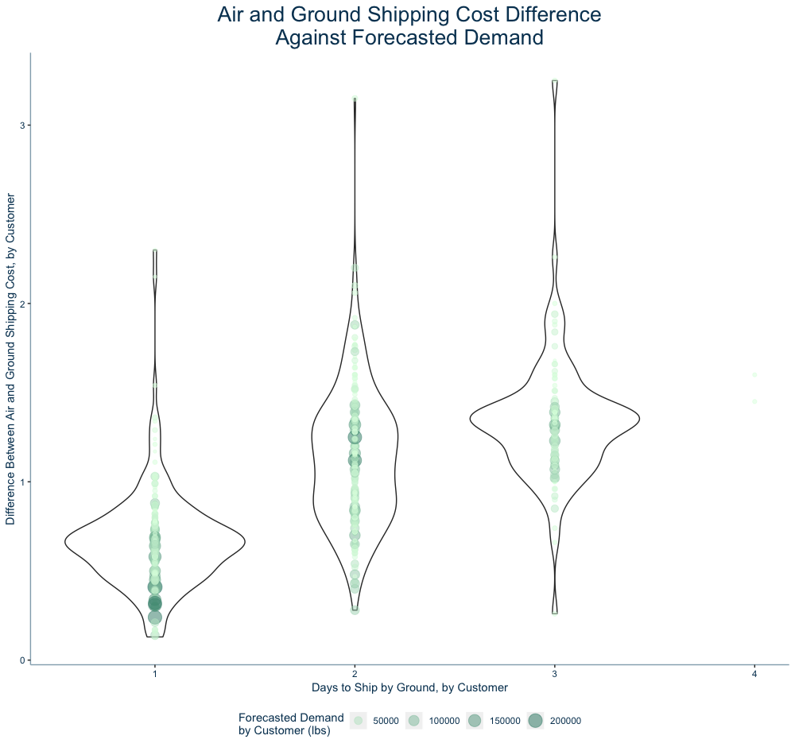
Time vs. Cost
The plot shows that there is a positive correlation between the difference in cost of air and ground delivery and time to ship by ground
No 4 or 5 day transits because after running our optimal distribution center plan, we will rarely see the package being delivered in more than 3 days
Thus, for most customers, it does not make sense to ship via next day air
Notes:
Again, because there is a positive correlation between the difference in shipping costs and the time to ship, for most customers it does not make sense to ship via air
Especially because given our distribution solution, shipping rarely takes above 3 days via ground

Slide 12

Revenue Stream
Although air shipping costs CRS more than ground shipping, some customers may elect to pay a fee to receive these items faster
Many of these customers are members of a cluster distinguished by high total shipping cost and a higher customer zone number – presumably west coast customers
Based on additional research, CRS can decide whether to set this fee to simply recuperate shipping costs or make profit through next day shipping
To break even, customers, on average, would pay $0.81/lb./day saved
Notes:
However, one reason to ship via air would be to potentially introduce a new revenue stream
It is possible to charge customers to have their delivery shipped via air – this can be used to simply offset CRS’s costs or to make shipping profitable
On average, customers would need to pay ~$0.81/lb/day saved for CRS to recover their air shipping costs
To decide on a price, however, CRS needs to collect more information (e.g. WTP of customers) before deciding on a strategy and price

Slide 13
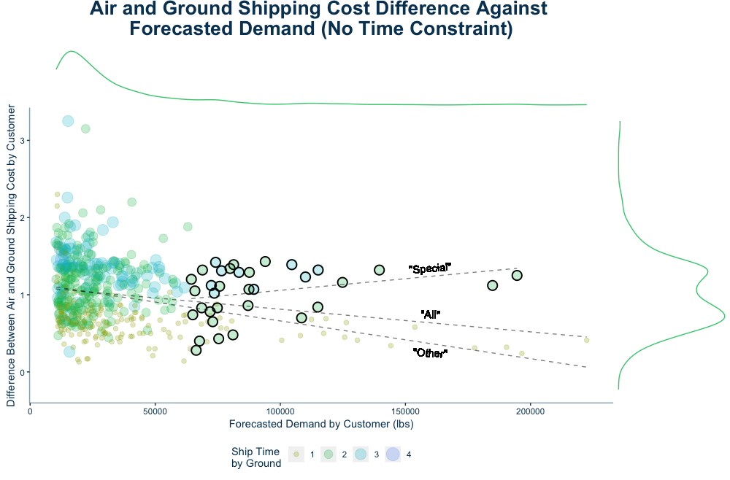
Customer Retention
As demand reaches ~6,400 lbs., the difference in shipping cost per pound never exceeds ~$1.50
This indicates there is a group of customers who order much more than most. They are important to CRS’s revenue and are not too costly to ship to via air
This is a sizable group, and they have long ground shipping times with the optimal distribution plan
Electing to offer these customers next day shipping provides them a better customer experience while increasing the likelihood of them continuing to purchase CRS’s products
Notes:
Another benefit to shipping via air is to incentivize customer to continue shopping with CRS
Customers who order large quantities are shipped to at a similar price regardless if CRS uses ground or air
These customers comprise a sizeable group and are a key source of revenue
Thus, offering them a better customer experience increases the likelihood of them staying with CRS

Slide 14

Customer Service & Time Trade-Off
Improving Customer Service Via Shipping Gurantees
While offering two day shipping is costly for CRS, improved shipping speeds provide customers with better service
Therefore it is crucial that CRS further weigh the costs and benefits of utilizing next day air in scope of customer service
One way to do this is to analyze the possibility of offering customers a shipping guarantee
This allows CRS to charge for shipping, provides them flexibility in combining ground and air transport, and provides customers with better service
Notes:
While improving customer service is important, it is also necessary to weight its benefits against its costs
Offering a shipping guarantee helps with this, as it allows CRS to offer improved customer service while holding flexibility in its shipping costs and methods

Slide 15
Shipping Guarantee
Some Rules:
If we cannot deliver the products on time via ground, we will choose next day air instead
Assume that we choose the “Five DC’s Plan”
Conclusion:
Costs nearly nothing to guarantee three day shipping
Guaranteeing two day shipping will cost about $3.45 million
Notes:
Guidelines for our proposed shipping guarantee: 1) If products cannot be delivered via ground in time, next day air is used. 2) We proceed with our 5 DC plan
Analyzing the costs under these constraints, we see that offering a three day shipping guarantee is not much more expensive for CRS but has major benefits in regards to customer service
Two day shipping is considerably more expensive, however

Slide 16
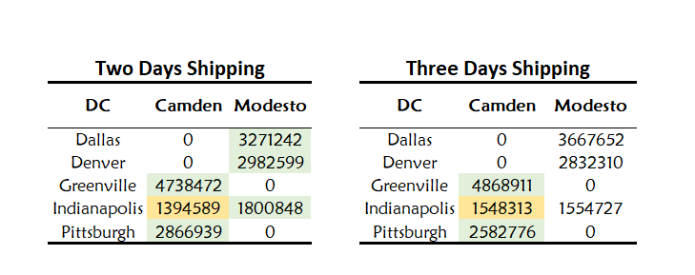
Shipping Guarantee
Distribution Plan’s Change:
Green: Larger than the original plan
Yellow: Smaller than the original plan
Notes:
This shipping guarantee affects our distribution plan in the following ways
For two day shipping, we increase our shipments to all plants except Camden to Indianapolis, which we reduce
For three day shipping, Camden to Greenville and Camden to Pittsburgh increase while Camden to Indianapolis decreases
Modesto shipments remain the same under the three day shipping guarantee

Slide 17
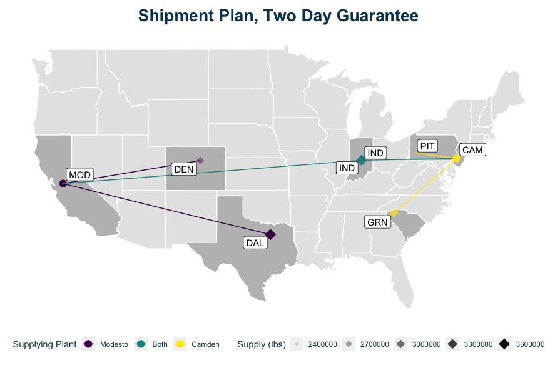

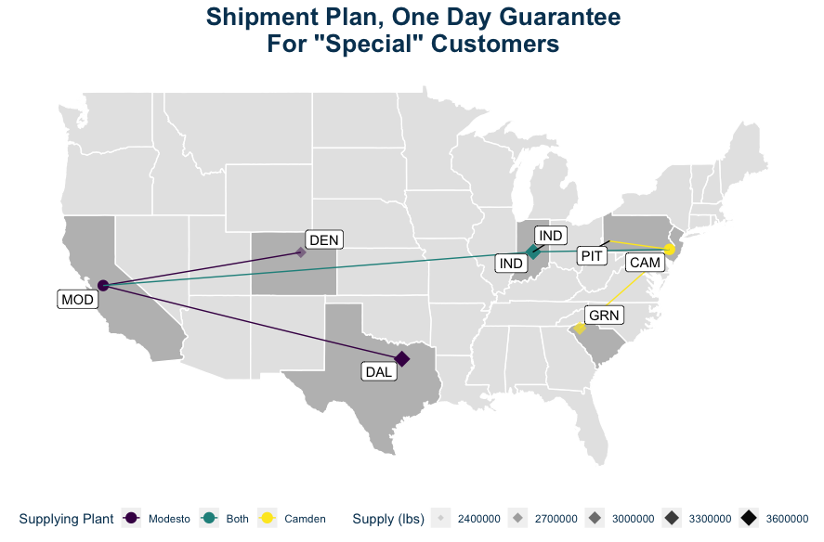
Notes:
-Notice when imposing two day shipping across all customers, or one day shipping for high demand customers, the cost-optimal plan remains the same with respect to distribution center locations
-Because the only changes are in quantity going to each distribution center, management can try either of these offers without the risk of wasted sunk costs

Slide 18
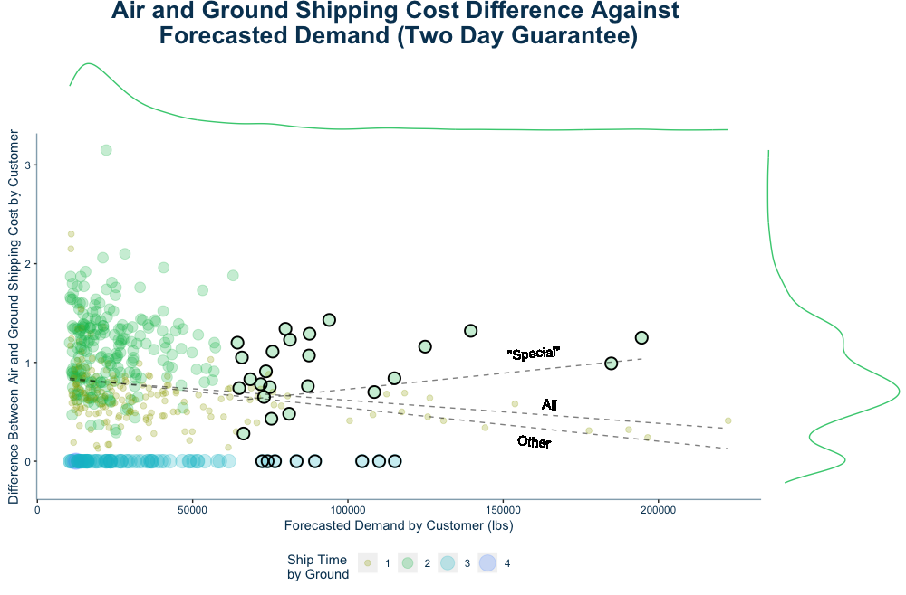
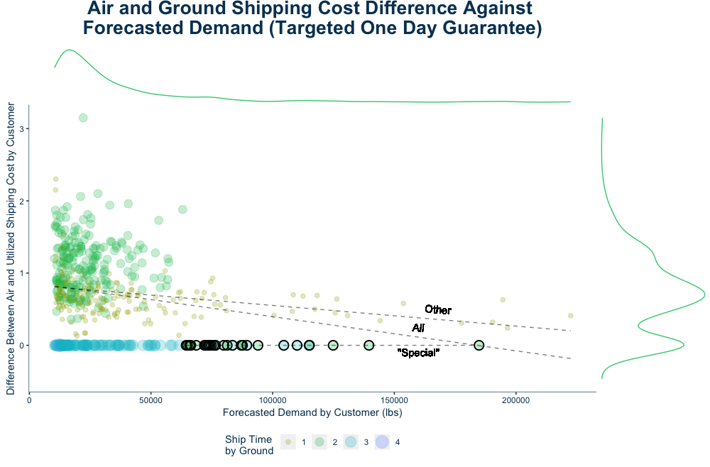
Shipping Guarantee
Two Day Guarantee
Targeted One Day Guarantee
Notes:
-Under the cost optimal plan with five distribution centers, the customer base as a whole shows a negative correlation between demand and difference in ground and air shipping costs
-this does not hold for the highlighted group of “Special” high demand customers
-in particular, there are 34 customers who have forecasted demands of over 64,000 lbs, and would not receive next-day shipping under the cost optimal plan
--this represents approximately 6% of the customer base and 18% of forecasted demand
-As we impose a two day guarantee, some of these customers, as well as lower demand ones, will receive their shipments via next day air
--this is because they have no shipping options that take less than three days
-By imposing a targeted one day guarantee, all high demand customers will receive their shipment within one day
--This may be worth the cost for this specific group of customers to keep them happy, but before implementing this plan, management should be confident that these customers do in fact value one day shipping at a sufficiently high level that it would be profitable.
-Lastly, as we implement this plan, notice that the relationship between the difference in cost and forecasted demand becomes negative, and closer in line with the general population
-In conclusion, while our five distribution center plan is cost minimizing, it happens to be the case that this plan necessitates delivery times to high demand customers. Because some costs are worth incurring more than others, if management believes these customers care about timely delivery, and if they happen to be bring the firm profit as well as revenue, slight changes can be made to the business plan without the need for new distribution centers.
-cost approx. $12,668,057

Slide 19
Shipping Guarantee
Benefits:
Improve Customer Service Increase retention rate Increase Revenue
Raise the price of our products Increase Revenue
Charge customers shipping fee Increase Revenue
Next Steps:
Build models to predict customer lifetime value and customer equity
Do break-even analysis based on the costs we estimated
Notes:
Benefits of this shipping guarantee include:
1) Improved customer service and retention, which leads to increased revenue
2) We can raise the price of our products if our brand is better regarded, leading to increased revenue
3) We can charge customers a shipping fee, which leads to increased revenue
Next steps in analyzing the shipping guarantee:
1) Build models to predict customer CLV and equity
2) Perform a break-even analysis based on the estimated costs

Slide 20
Capacity Analysis
Would it be profitable to increase capacity at either plant?
Since the capacity of plant Camden is a binding constraint, we consider increasing the capacity of this plan to reduce cost
Initial Reduced Cost: $-0.09/pound
Next Steps:
1. Find the costs of increasing capacity
2. Make a decision based on this curve and a break-even analysis
Notes:
Would it be profitable to increase capacity at either plant?
Since the capacity of plant Camden is a binding constraint, we consider increasing the capacity of this plan to reduce cost. From the sensitivity report, we find that the reduced cost for this constraint is -0.09, and the upper bound is 11085119, which means when the capacity is lower than 11085119, an extra pound of capacity will reduce the total cost by $0.09. We simulated different scenarios, and got the relationship between the capacity increase and the total cost, which is shown in the above curve. If we know the cost of increasing capacity, it is easy for us to make a decision based on this curve.
* Ultimately, increasing capacity at the Camden plant has potential to reduce CRS’s costs depending on the price of increasing capacity

Slide 21




Recommendations
Our Analysis Shows CRS Should:
Have 5 distribution centers to save costs while minimizing future expenditure
Charge customers for next day shipping
Retain customers by offering next day shipping to high value customers
Build brand equity through quick shipping and a three day shipping guarantee
Customer Retention
Brand Equity
Increase Profits
Shipping Guarantees
Increase Profits
Customer Retention
Increase profits by cutting costs and charging for air shipping
Incentivize customers to keep purchasing from CRS
Brand Equity
Shipping Guarantees
Build and differentiate brand through faster shipping speed
Improve customer experiences with shipping guarantees
Notes:
Ultimately, we recommend the following for CRS:
1) Implement our 5 DC plan. This significantly reduces cost while minimizing future expenditures in DC development
2) Charge customers for next day shipping. Either to recuperate costs or to make additional profit
3) Retain customers by offering next day shipping – especially to high value customers
4) Build brand equity through quick ship times and a three day shipping guarantee

Slide 22








Conclusion
Optimizing CRS’s Operations
Distribution
Proper placement of 5 new distribution centers can save CRS money and ensure shipment to customers with greater speed
Next Day Air
Next day air allows customers to receive their packages in 3 days at minimal cost, while offering CRS a new revenue stream
Customer Service
Faster shipping speeds ultimately increase CRS’s brand equity and help the company retain valuable customers
Other Insights
Understanding the effects of capacity constraints drives actions CRS can take to optimize distribution and further increase revenue
Notes:
In conclusion
Strategic placement of new distribution centers saves CRS money ensures quicker shipping times
Next day air, while more expensive, offers CRS a new revenue stream while decreasing shipping times
Faster shipping speeds then lead to improved customer service, which increases CRS’s brand equity and helps them retain valuable customers
Additional analysis, such as understanding the effects of changing the capacity constraints, shows how CRS can continue to optimize their distribution and increase profitability

Slide 23
Future Steps
Further Analysis We Wish to Complete:
In general, Camden has lower inbound freight costs. If we increase the capacity of the Camden plant, how much more cost can we reduce to further streamline our process?
Perform capacity sensitivity analysis, to see how much CRS should invest in capacity adjustment
Notes:
We wish to continue our analysis, specifically through the following
1) Understand how freight costs may change with capacity – and understand how this can further improve CRS’s processes
2) Perform a sensitivity analysis on the plants’ capacity to see how much CRS should invest in this endeavor

